Slide 1
Heinrich Schliemann
By:Spencer Harrington

Slide 2
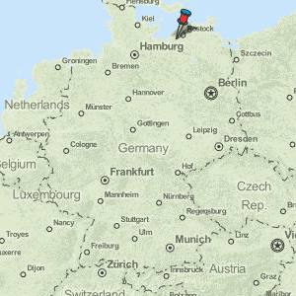
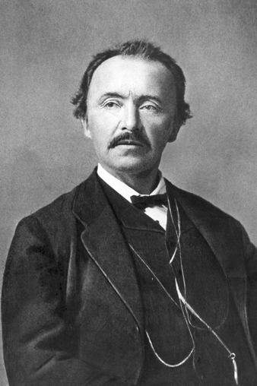
Who was he?
Born: 6 January 1822
Birthplace: Neubukow, Germany
Died: 26 December 1890
Place of Death: Naples, Italy

Slide 3
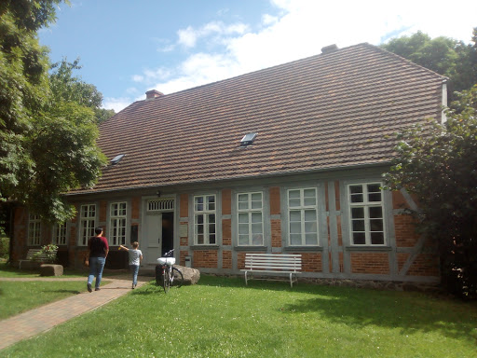
Childhood
Was born as Julius Schliemann but changed name to Heinrich.
Moved to Ankershagen in 1823
By age seven, he was determined to find Troy.
Mother died when he was nine, meanwhile his father had an affair
Family had split up due to the embarrassment
Notes:
Was born as the fifth child in his family
Changed his name to Heinrich to remember his brother who died 10 weeks before Julius’ birth

Slide 4
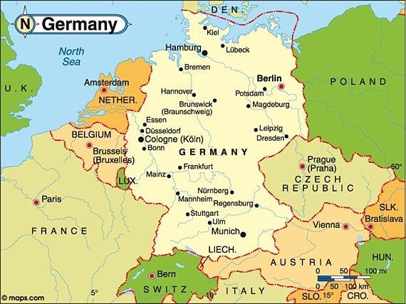
Teenage Years
Went to a vocational school after his father was accused of embezzling money.
Left the vocational school to become an apprentice grocer
After working for 5 years, left being a grocer after bursting a blood vessel
Moved to Hamburg, Germany and worked as a cabin boy on the Dorothea
Ended up in Amsterdam due to the ship crashing.
Notes:
His passion for Homer increased after he met a drunken miller who recited Greek and Homer

Slide 5
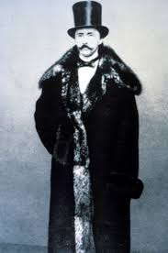
Young adult
1844, took position at B.H Schröder & Co. an import/export firm
Was later sent to St. Petersburg
Learned several languages which became a crucial part of his career and in the future.
Traveled to United States after the death of his brother Ludwig: Gold miner
Started his own bank and made over a million dollars in six months in Sacramento
Retired at 36: Started career as an archaeologist
Notes:
2. In Saint Petersburg, he started selling many iteams which included Indigo.
4. After his time in the United States, he went back to St. Petersburg married Ekaterina Petrovna Lyschem:

Slide 6
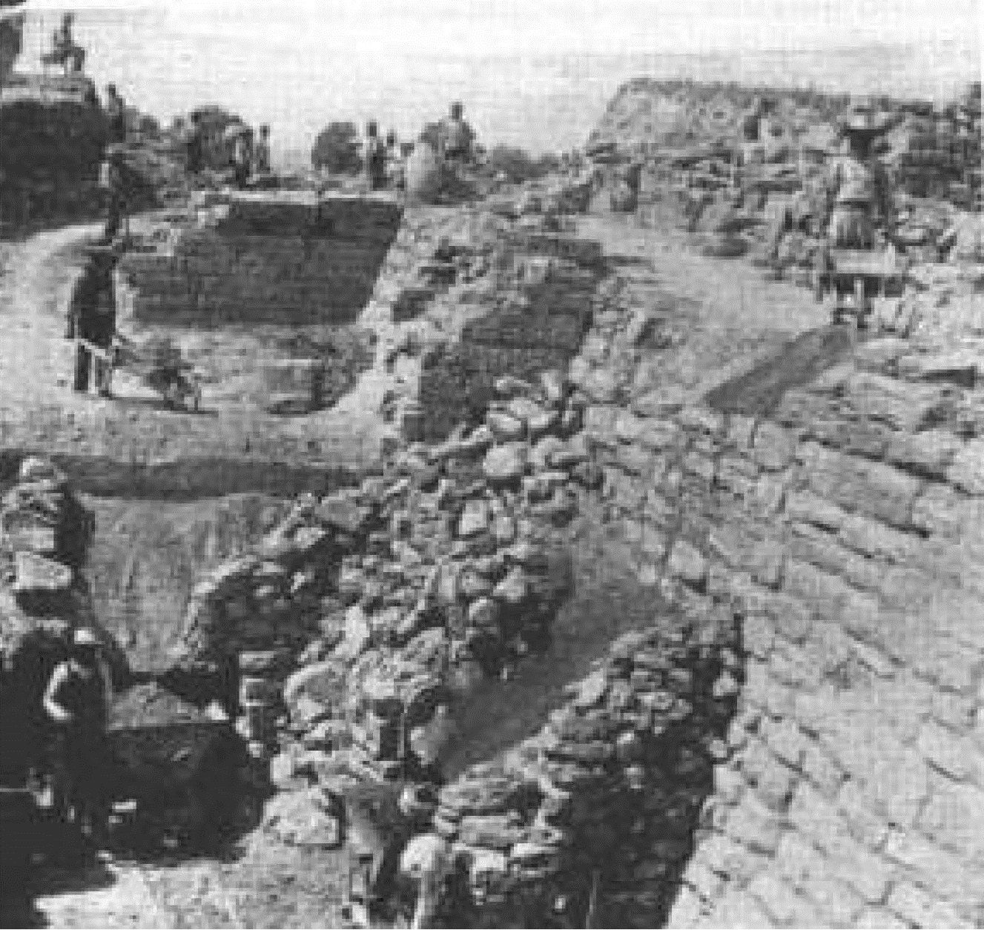
LIFE AS AN ARCHAEOLOGIST
First dig was Hissarlik in 1870 illegally
Returned home: his wife and children were gone.
Sophia Engastromenos, married had two children: Andromache and Agamemnon.
Returned again in 1870 , dug illegally again
Excavated Mycenae 1876: found the “Mask of Agamemnon”
Notes:
Troy pictured on the right.

Slide 7
Cont.
His techniques made people furious
Used chains, jackscrews, tore down anything in front of him.
Cared more about speed then precision
Smuggled jewels and gold back to United States
Took a crown that had over 16,000 pieces in it

Slide 8
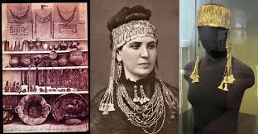
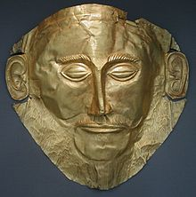
Notes:
Treasures of Troy : His wife Sohpia :the headdress she wore, being kept in the Pushkin Museum in Russia
Mask of Agamemnon is located in the National Archaeological museum in Athens Greece

Slide 9
Excavations
1884
Tiryns
1880
Orchomenus (Boeotia)
1876 Mycenae
1870 First Excavation of Hissarlik
1879 Second Excavation of Troy
1882 Third Excavation of Troy
Fourth and Final Excavation of Troy
1890 Death
1878 Ithica
1873 Troy is Found

Slide 10

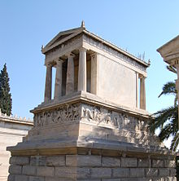
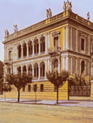
Death and His Significance
1890: Travelled to Athens, Halle, Naples, Pompeii
Died December 26,1890 from a coma caused by Chronic ear infection
Buried in Athens
He is credited to finding Troy, Mycenae, Tiryns
Although damaged much of Troy but his passion and desire made him successful
Is excavations brought greater awareness to the ancient history of the region.

Slide 11
Bibliography
Google Images
Heinrich Schliemann. By: Kitchell, Kenneth F., Jr., Salem Press Biographical Encyclopedia, 2020
Kuiper, Kathleen and Daniel, Glyn Edmund. "Heinrich Schliemann". Encyclopedia Britannica, 2 Jan. 2021, https://www.britannica.com/biography/Heinrich-Schliemann. Accessed 1 February 2021.

